Slide 1
Challenges from first year experience in PhD studies at Contemporary Sciences and Technologies at the South East European University
by Betim Cico, Zamir Dika
14th Workshop “Software Engineering Education and Reverse Engineering” Sinaia, Romania, August 2014

Slide 2
<< Until now
University was founded in 2001, only 13 years Experience.
Mainly two types of studies.
started with 4 years studies
continued with regular bachelor, master studies and mentorial PhD studies.

Slide 3
CST Staff members
2 professors
2 Associated professors
14 Docents(6 staff members based on mentorial form of PhD study in our university)
5 PhD Students ( One continue the studies in technical University of Vienna, two in Kiel-Germany and one in Skopje in regular PhD studies and one in SEEU based on mentorial studies). All supervisors from outside of the University.
still we have two PhD students ( not staff members) outside University with mentorial form.

Slide 4
Research and PhD Studies
Until now there is not any real research based of the PhD studies.
From the last year are organized research groups based of the teaching subjects.
There where no any real connection between the PhD of different staff members and research groups.

Slide 5
Research and PhD studies
To increase the capacity of the University there has been taken the decision to have regular PhD studies in the University from 2013 in accordance with the new Law.
To be transferred from teaching-oriented towards Teaching and Research University.

Slide 6
Challenges
Students selections 2013 – 2014 in CST Faculty
16 applications, we select 8 of them which fulfill the condition of the Ministry of Education:
Average grade of BSc and MSc studies more than 8.00
TOEFL results as a precondition to enroll.

Slide 7
Challenges
Supervisors:
To be approved from accreditation board of R. of Macedonia based of the three last year publications (to have the title of Associate Professor or Professor).
Approved: 5 professors (two from Full time staff, two from Part time staff and one Academician from Albania)
From the law 5 professors can supervise (5x3 = 15 PhD Students).

Slide 8
Challenges
For this year we are going to have three more approved professors (two from Germany and one from Albania).
All supervisors – Full Professors.
How to do MENTORSHIP?
What we (mentors) want to achieve mutually with students?

Slide 9
Regular PhD Studies (first year)
Program approved from accreditation board
50% of subjects (three) obligatory and 50% (three others) Elective.
There aren't many Elective courses for Specific areas.
All courses where done with Full Professors (three from our University, two from German professors and one from Albanian Professors).
Our opinion and feedback from the students: High level of first year studies.

Slide 10
Subjects and exams
Project based, the possibility to increase the innovative ideas of the PhD Students.
Students are “happy” with project based modules.

Slide 11
Some comments from Students…
Te nderuar Drejtues te Universitetit te Evropës Juglindore.
Me mbarimin e mësimeve pas dy semestrave, do te donim të ju falënderonim fillimisht për mundësinë qe na dhatë për te vazhduar studimet e PhD pranë këtij Universiteti.
E vlerësojmë shume qe si ne semestrin e pare ashtu edhe ne semestrin e dyte u angazhuan tre profesorë Ordinare nga ky Universitet dhe 3 profesorë te tjerë ordinar nga Universiteti i Tiranës, Universiteti Humbold i Berlinit dhe Universiteti Philips i Marburgut.
Me anë të këtij email-i dëshirojmë te shprehim respektin më të lartë për të gjithë profesorët që patëm rastin me na dhënë mësim por me këtë rast donim të ju falënderonim veçanërisht juve dhe Dekanin e Fakultetit CST, Profesor. Betim CICO për mundësinë e angazhimit sidomos te dy profesorëve Gjerman:
Prof. Klaus Bothe në Advanced Software Engineering dhe
Prof. Bernd Freisleben ne Advanced Topics in the field of Information and Communication Technologies.
Donim te shprehim kënaqësinë për ofrimin e mësimdhënies me shumë kualitet e sidomos ardhja e profesorëve gjerman ishte një risi shume pozitive dhe motivuese çfarë do rekomandonim fuqishëm edhe për gjeneratat e ardhshme.
Faleminderit edhe njëherë për mundësitë qe na krijuat
Me respekt,
Grupi i Studenteve te PhD te CST-se:
1. Blerim Voca, 2. Arten Avdiu, 3. Ilir Keka, 4. Agon Memeti, 5. Lindita Nebiu, 6. Dhurate Hyseni, 7. Burim Avdiu, 8. Bukurie Shabani

Slide 12
Some comments from Students…
Dear Management of the South East European University. By the end of lessons after two semesters, would like to thank you first for the opportunity you gave us to continue PhD studies at the University. What we appreciate more is the fact that in the first semester and the second semester there were engaged three full professors of this university and the other 3 Full professors from the University of Tirana, Humboldt University of Berlin and the Philips University of Marburg. With this email we would like to express our highest respect for all the teachers who had the opportunity to teach us, but on this occasion we want to thank you especially to you and CST Dean of the Faculty, Professor. CICO oath to the possibility of engaging especially the two German professors: Prof. Klaus Bothe in Advanced Software Engineering and Prof. Bernd Freisleben in Advanced Topics in the field of Information and Communication Technologies. We wanted to express our satisfaction with the provision of quality teaching more especially the arrival of German professors was a very positive and motivating innovation what will strongly recommend to future generations. Thank you once again for the opportunities that you develop for us Respectfully, PhD Student Group of the CST-that: Blerim Voca 1, 2 Arten Avdiu, Ilir Keka 3, 4 Agon Mehmeti, Lindita Nebih 5, 6 Grant Husayn, 7 Source Avdiu, 8 Beauty Shabani

Slide 13
Research Methodology and the PhD studies
The subject that increased the research abilities of PhD Students – we have tried to connect the subject with PhD Students thesis ideas.

Slide 14
Increasing the research capacities
Creating the hierarchy of the research
Mentor
Two to three Post. Doc. Staff members for each PhD student (research group based)
3 PhD students
6 Master students

Slide 15
PhD Conferences
PhD studies and PhD Conferences.
We organized the first PhD Conference in our University together with German Partner.
Around 20 participants from Macedonia, Albania, Germany and Norway.
To establish annual PhD conference
We are open for collaboration ……….
To increase student participation in Conferences

Slide 20
Actual Research at SEEU
Struga’s Seminar August 2014
and part of the presentation
of the Rector Prof.Zamir Dika
Member of CST Faculty
Notes:
Imam problem sa sobom

Slide 21
Actual Research at SEEU
Here are some of the questions that we ask each other….
Why are we not using library resources and demanding more for research?
Why are we (not honest with each other) putting our name as author without input/ field?
Why are we so focused on short term papers instead of building longer term, deeper research?
Why are we not working in field teams enough, experienced research supporting others?
What can we do to improve our research profile?
Notes:
Imam problem sa sobom

Slide 22
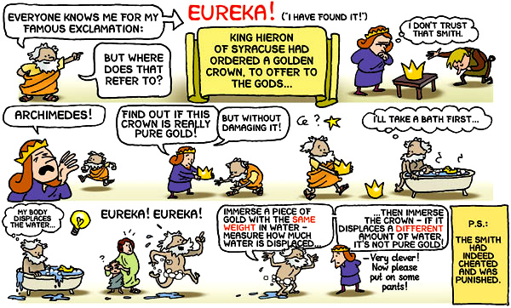

Slide 23
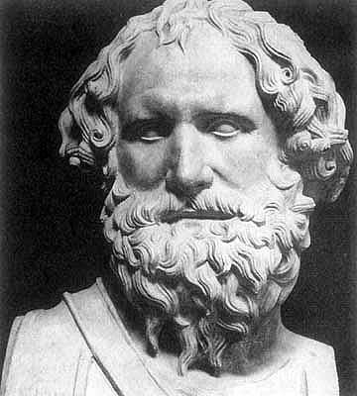
Archimedes Research Principles
Intellectual commitment
Responsiveness to external research questions/needs
Innovative thinking,
24/7 thinking and working,
Integrity,
Measurable, repeatable results,
New knowledge,
Accountability, Applicability, Success (we hope he got paid!)

Slide 24
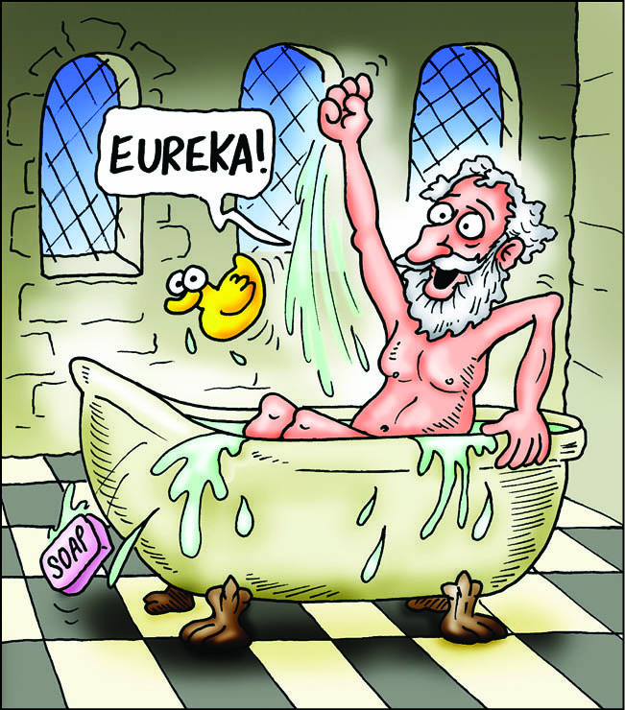
We are like this:
Aiming to become like this:

Slide 25
Conclusion
Hard work to establish the regular PhD School
Increasing students responsibility for the research work.
Increasing the research level.
Creating the possibility to participate in International projects (Horizon 2020).
Student to spend more time in laboratory

Slide 26
Photos
German professors teaching our Students. Thanks to prof. Freissleben from Marburg Univeristy and especially to prof. Klaus for excellent and high level contribution to our PhD studies.

Slide 28
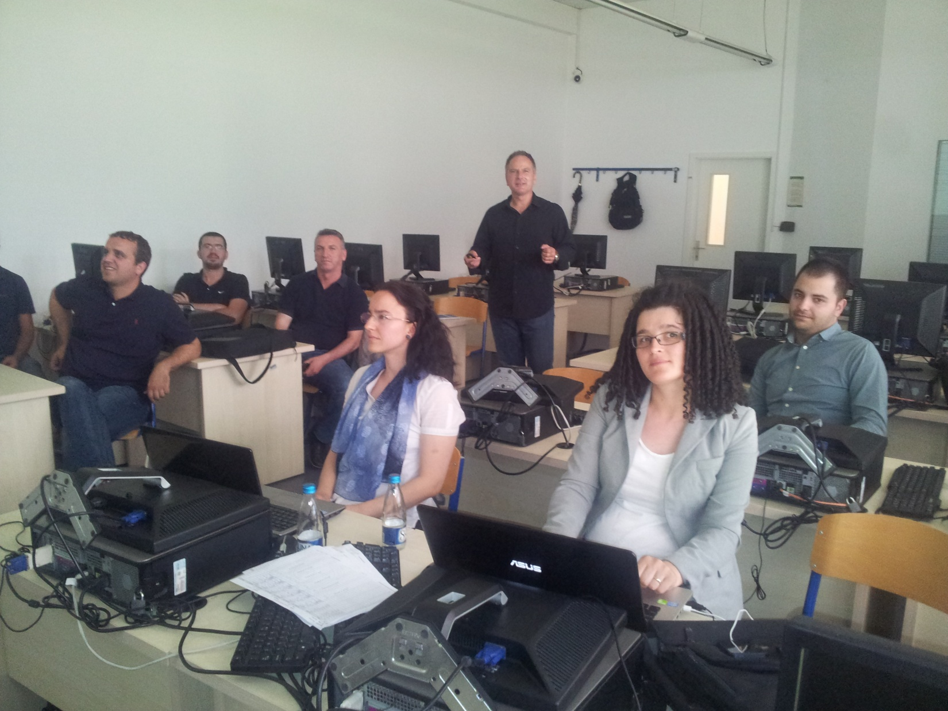

Slide 29
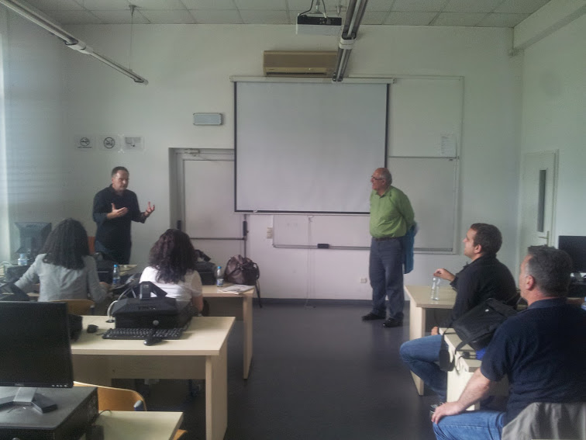

Slide 34
Questions? & Thank You for your attention!

